Slide 1
AMAZON PRODUCT REVIEW ANALYSIS (BOOKS & KINDLE) by Aishwarya Sonawane , Sweety , Komal Khanna , Rakesh Singh
1

Slide 2

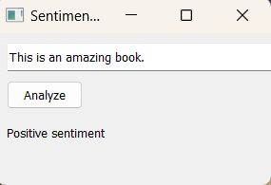
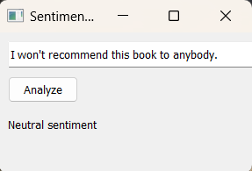
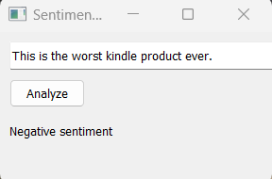
INTRODUCTION
2
With the quick growth of internet and its increasing accessibility, e-commerce has developed rapidly in the last few years. With the introduction of e-commerce shops, we can buy anything with a click of the mouse.
Since in online shopping, customers are not able to feel and touch the product, most of the customers on any shopping sites, make purchasing decisions based on reviews and ratings.
Here, amazon review dataset for Books and Kindle store is considered. And based on different criteria obtained from this project we help the consumer and the marketing industry to get the best out of the review system.

Slide 3

OBJECTIVE Customer Retention And Sentiment Forecasting
3
Analyzing customer feedback through natural language processing techniques can help businesses identify key themes and sentiment in customer reviews. By classifying and clustering customers based on their review text, businesses can develop targeted retention strategies for each group.
Trend and seasonality analysis to predict how frequently a particular category of customers would shop in the future (Time series analysis).

Slide 4

OVERVIEW
4
BUSINESS SOLUTIONS
TIME SERIES ANALYSIS
CLASSIFICATION & CLUSTERING
SENTIMENT ANALYSIS
EXPLORATORY DATA ANALYSIS
PREPROCESSING AND CLEANING

Slide 5

ABOUT THE DATASET
5
Dataset : https://cseweb.ucsd.edu/~jmcauley/datasets/amazon_v2/
Products Reviewed Between years 1997 and 2018 are analyzed
Number of Files : 4
Files Format : Json (Java Script Object Notation)
Number of Reviewers(Books) : 1,66,092
Number of Reviewers(Kindle) : 1,44,380
Columns | Description
reviewerID - | Id of the Reviewer
reviewername - | name of the Reviewer
reviewertext - | text of the review
summary - | summary of the review
overall - | rating on a scale 5
asin - | ID of the product
unixreviewrime - | time of the review (unix time)
reviewtime - | time of the review (date)
brand - | brand of the product
title - | title of the product
price – | price of the product
category – | category of the product
verified- | actual vs fake reviews

Slide 6






PREPROCESSING & CLEANING
6
Data Importation
Data Exploration
Missing Value Treatment
Splitting the dataset
Label Encoding
Feature Selection

Slide 7

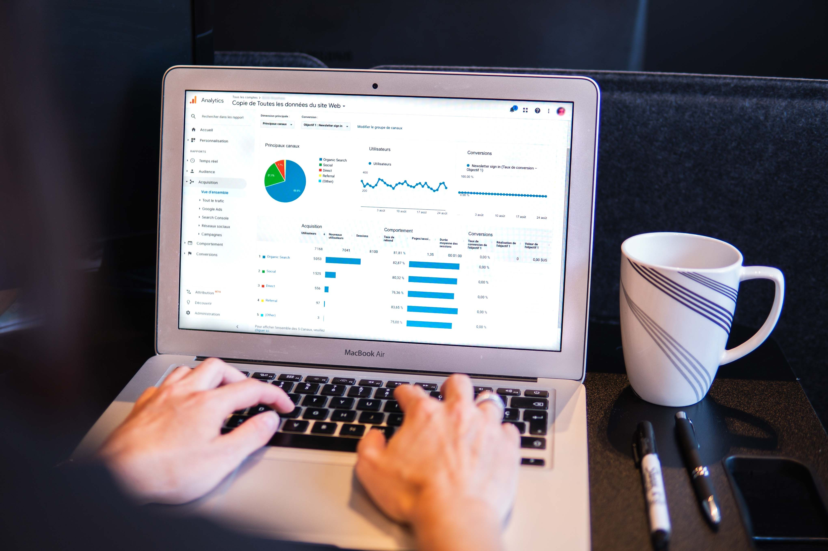
7
Exploratory
Data
Analysis
Univariate Analysis
Bivariate Analysis
Multivariate Analysis

Slide 8
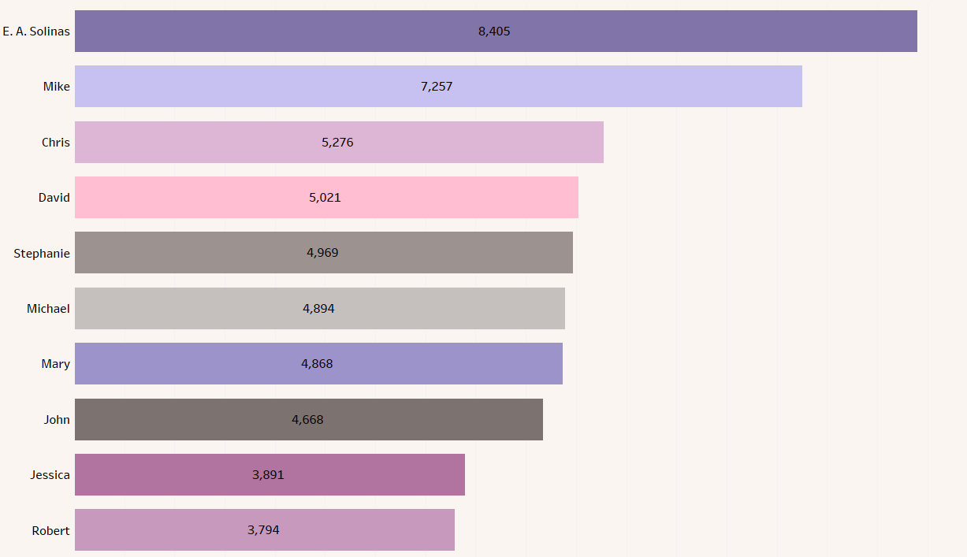

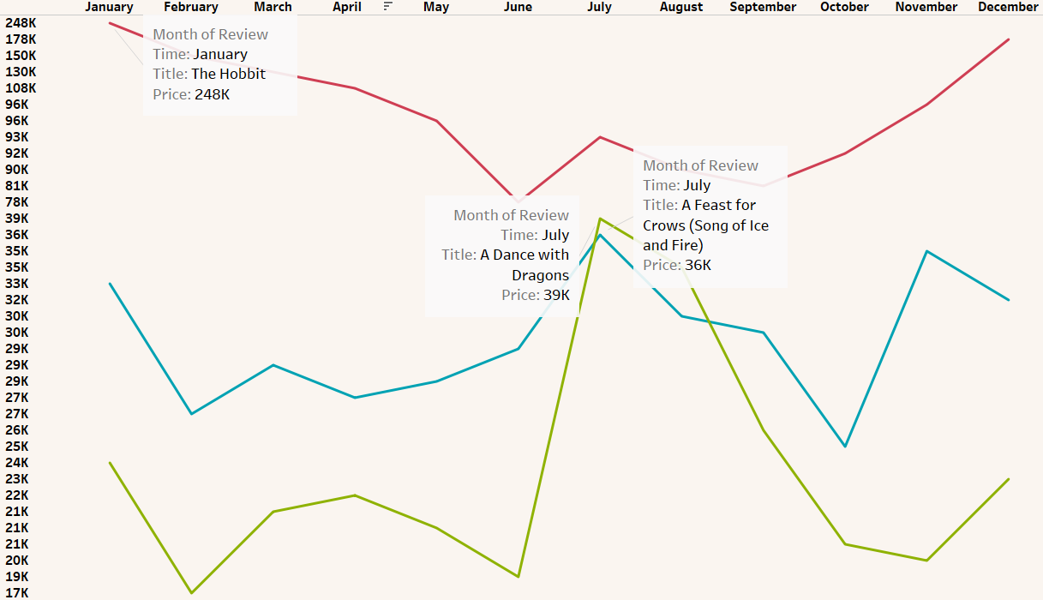
8
REVENUE WISE TOP CUSTOMERS
Conclusion- By identifying the top customers, a business can focus on retaining these customers and providing them with excellent customer service and personalized offers to keep them coming back.
MONTH WISE REVENUE
Conclusion- By analyzing the revenue trends over time, businesses can identify which months tend to be the strongest revenue generators and which months are typically slower.

Slide 9
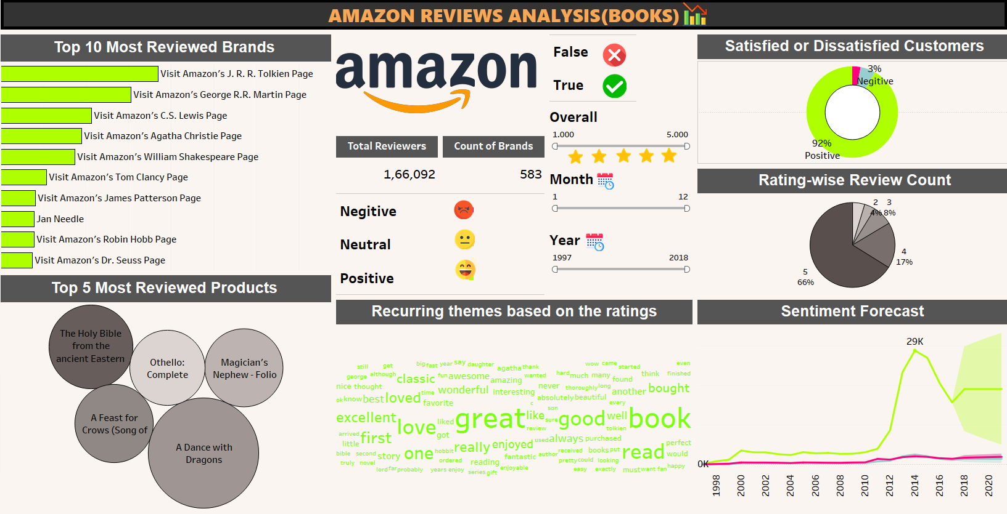
9
9

Slide 10
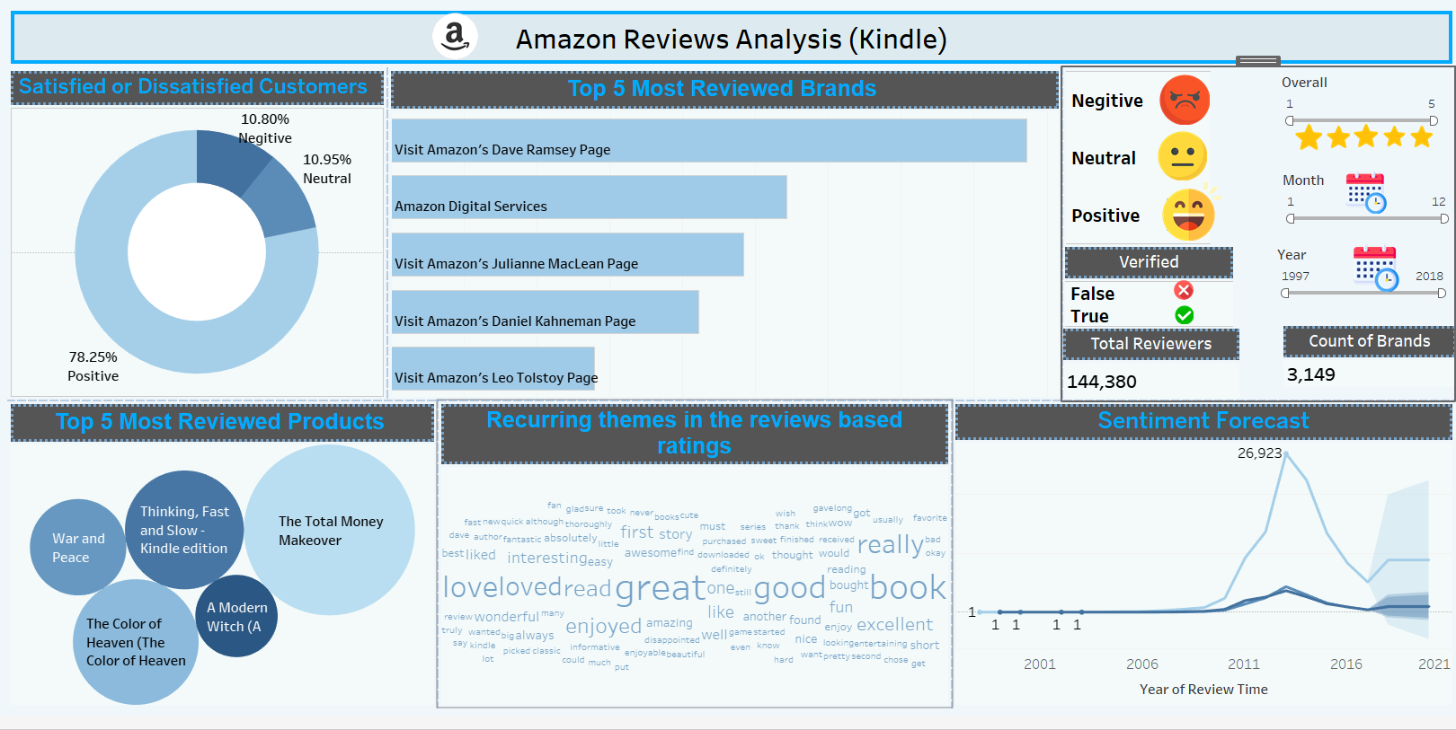
10
10

Slide 11

SENTIMENT ANALYSIS
11
Sentiment analysis is a text analysis method that detects polarity i.e., a positive , negative or neutral review , within the text, either a whole document, paragraph, sentence, or clause.
"VADER" refers to the "Valence Aware Dictionary and sentiment Reasoner." VADER is used to convert the reviews of the customers into Sentiments to make the data more understandable.

Slide 12

TEXT CLASSIFICATION
12
Text Classification is the process of categorizing text into organized groups.
Using TFIDF (Term Frequency Inverse Document Frequency) for converting text into numbers.
N-Gram (Unigrams , Bigrams , Trigrams )
Logistic Regression , Decision Tree , Random Forest Classifier , KNN , Naïve Bayes are used to predict sentiments from review text.

Slide 13

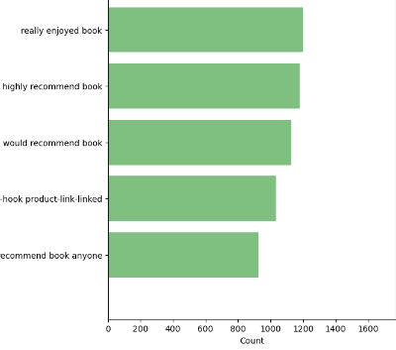
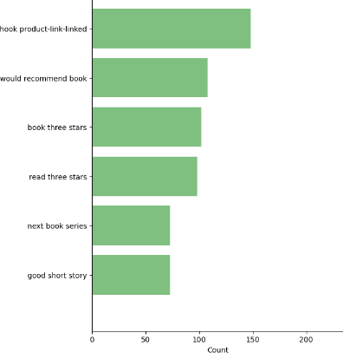
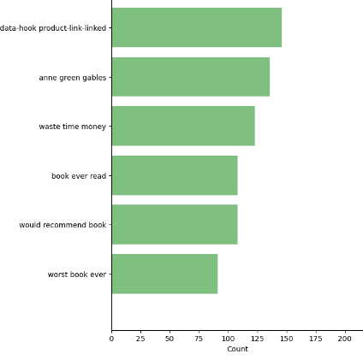
N-GRAMS
13
POSITIVE TRIGRAM
NEUTRAL TRIGRAM
NEGATIVE TRIGRAM
Conclusion- Analyzing negative interpretation trigrams can be a useful tool for businesses and organizations looking to gain insights into public opinion and sentiment.

Slide 14

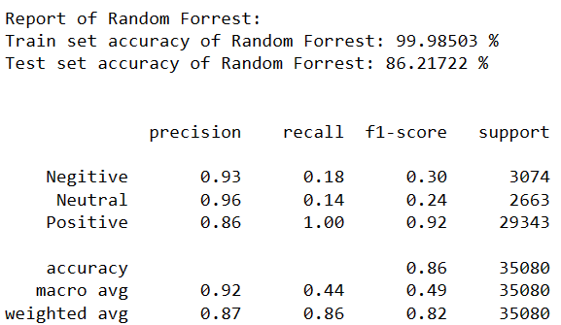
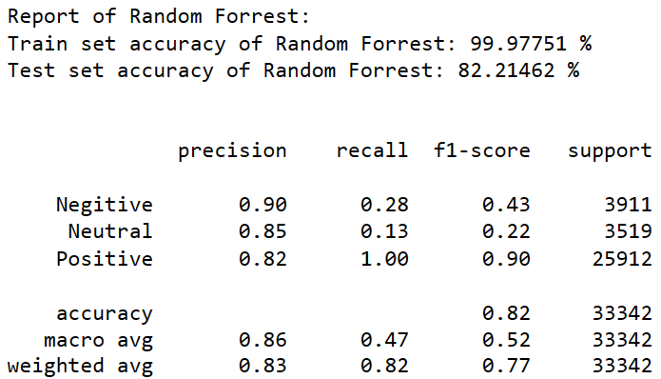
MODEL CLASSIFICATION
14
Best Model for Book Store – Random Forest Model
Best Model for Kindle Store - Random Forest Model

Slide 15
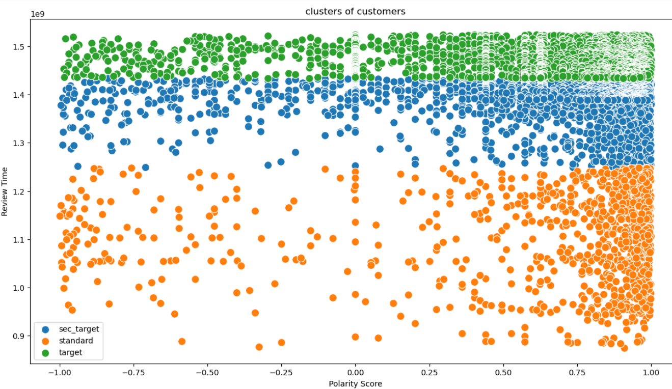
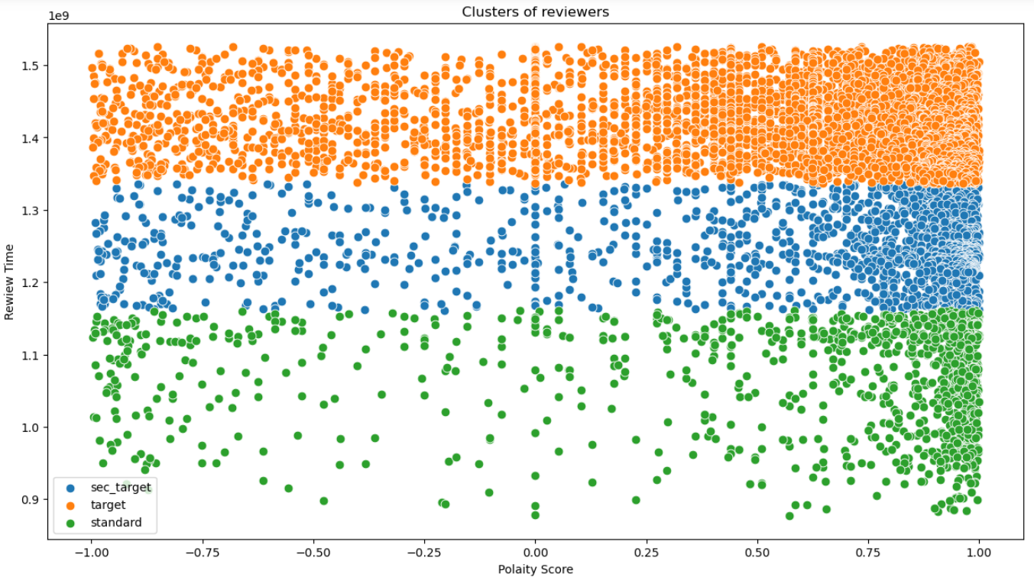
CLUSTERING is a technique that involves grouping similar data points together. The goal of clustering is to identify patterns and structures within a dataset, and to group data points based on similarities or differences in their features.
15
BOOKS CLUSTERING
KINDLE CLUSTERING

Slide 16


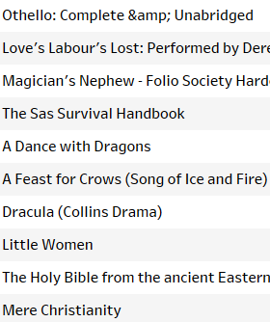
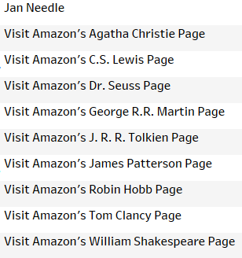

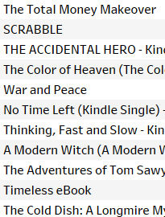

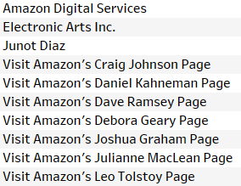
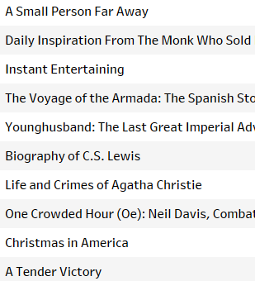

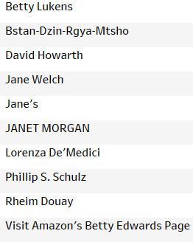
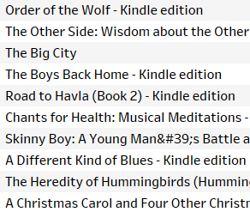
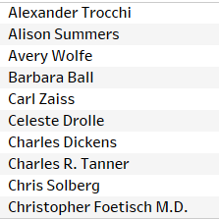
Top And Bottom Products/Brands
16
BOOKS PRODUCTS
BOOKS BRANDS
KINDLE PRODUCTS
KINDLE BRANDS
TOP
BOTTOM

Slide 17

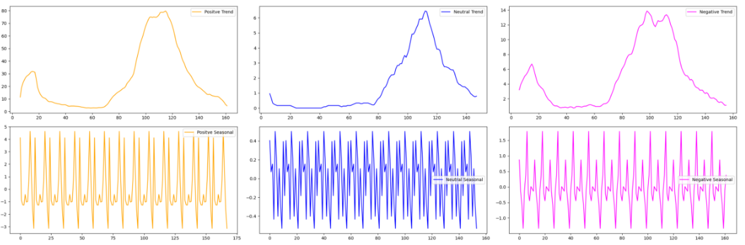
Time Series Analysis
17
Time Series Analysis refers to a set of data points that are collected over time, typically at regular intervals.
The data have both trend and seasonality.
By analyzing historical patterns in the data, we can identify trends, seasonal patterns, and other factors that may be influencing the data which is used to create a model that can forecast future values of the data.

Slide 18
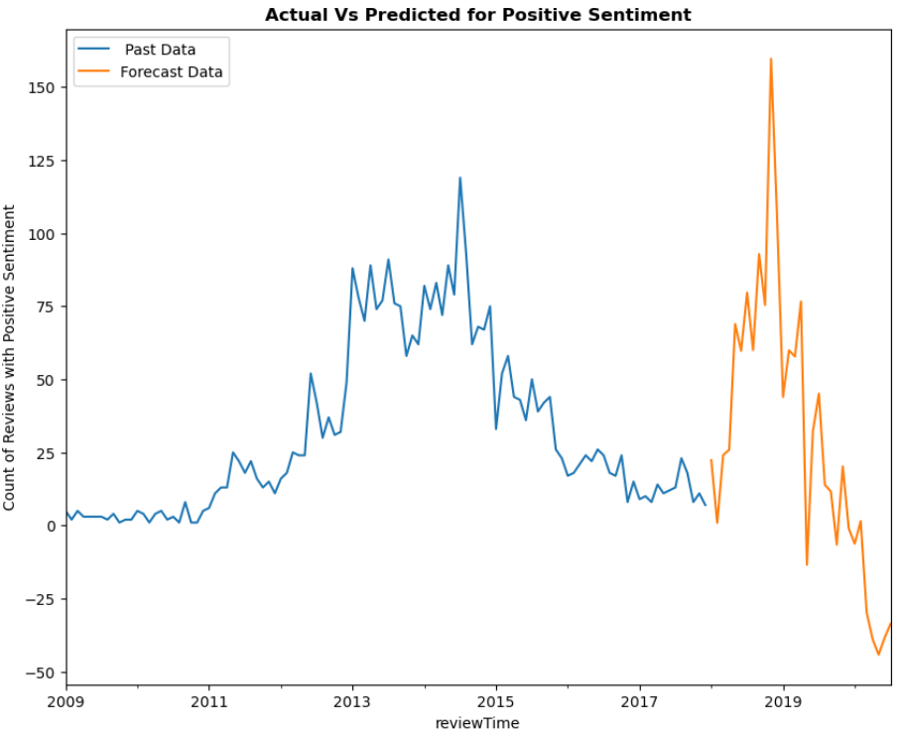
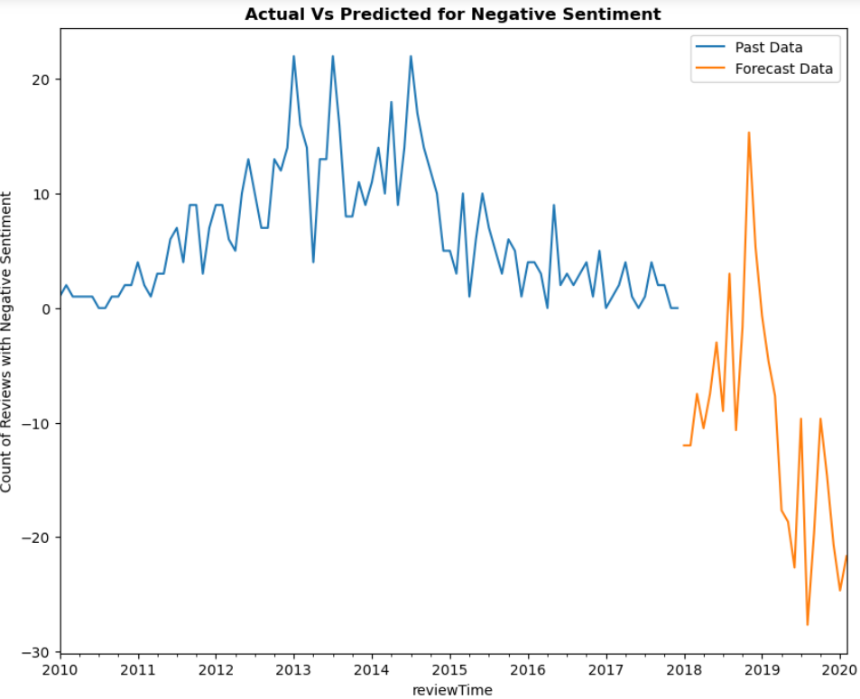
Time Series Analysis – Book 1
18
Product - A Dance With Dragons(for positive sentiments)
Product- A Dance With Dragons(for negative sentiments)

Slide 19
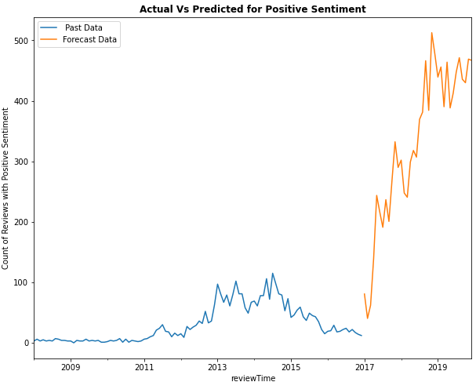
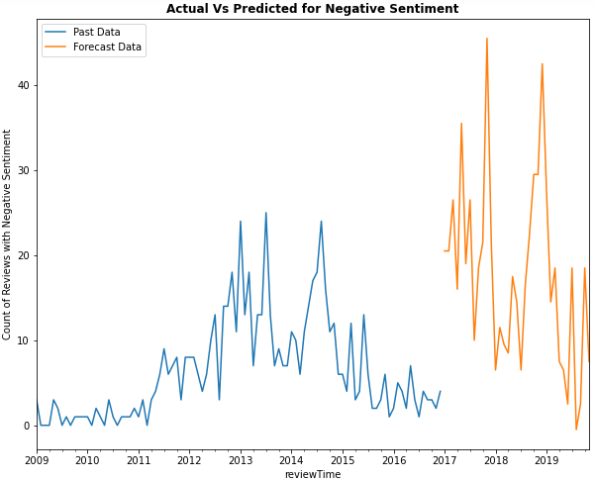
Time Series Analysis- Book 2
19
Product-A Feast For Crows(for positive sentiments)
Product-A Feast For Crows(for negative sentiments)

Slide 20


Recommended Products
20
Books
Kindle
The Hobbit
The Total Money Makeover
A Dance With Dragons
Thinking ,Fast & Slow
A Feast For Crows
The Color Of Heaven
Magician’s Nephew
War & Peace
Othello
A Modern Witch

Slide 21

Business Interpretations
21
Identify Popular Product/ Brands
From the top and bottom products and brands , we can conclude that the product is meeting the expectations of the customers or not. On that basis, we can invest in or improve the product quality.
Recommendations To Customers
By identifying trends and patterns in the purchasing behaviour of the top customers ,business can use this information to recommend similar products.
Predictions based on reviews
Overall , time series analysis by using reviewer id grouping with sentiment of review text ,businesses can predict the sentiments over the period of time and make data-driven decisions.
Brand Reputation Management
By addressing the sentiments of the most reviewed brands, businesses can highlight positive reviews on the website, social media platforms to showcase their business's reputation, whereas from negative reviews it can learn and implement the required changes.

Slide 22

THANKYOU!
22

